Slide 1



The Art of Intelligence A Practical Introduction to Machine Learning
Lucas Jellema, CTO of AMIS
Oracle Groundbreakers APAC Tour
AUSOUG Connect 2018, Perth

Slide 2


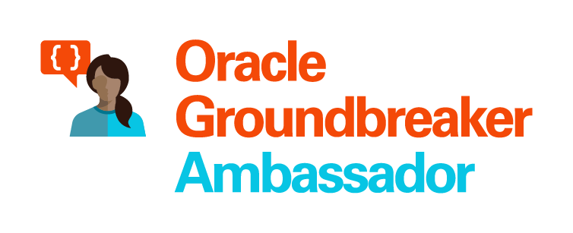


Lucas Jellema Architect / Developer 1994 started in IT at Oracle 2002 joined AMIS Currently CTO & Solution Architect

Slide 3
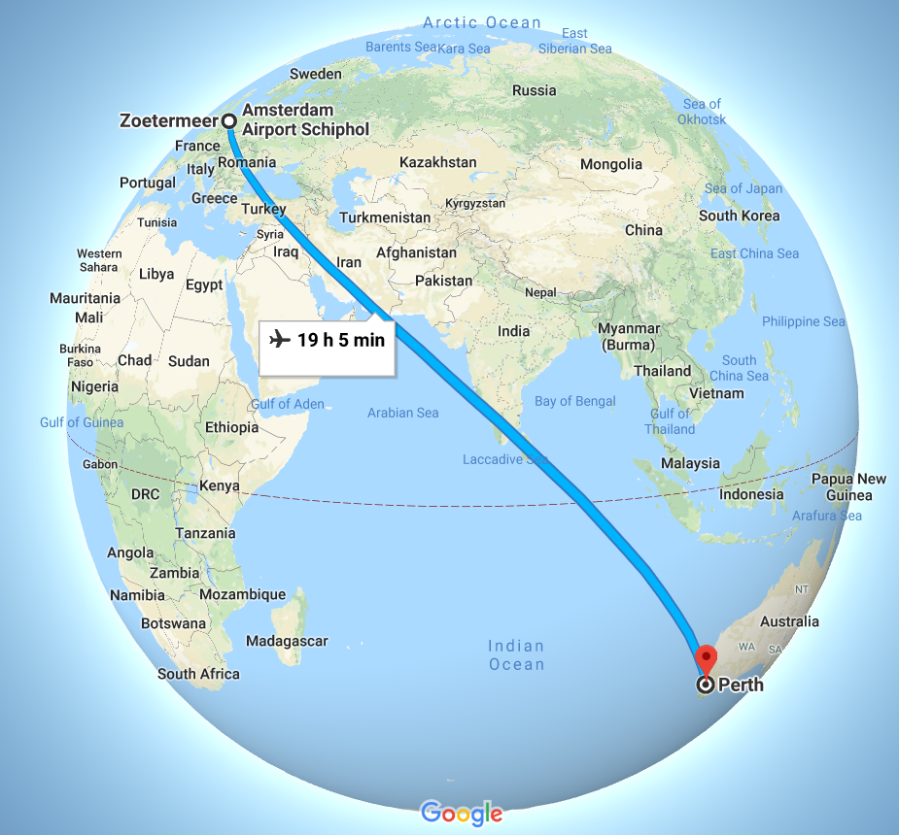
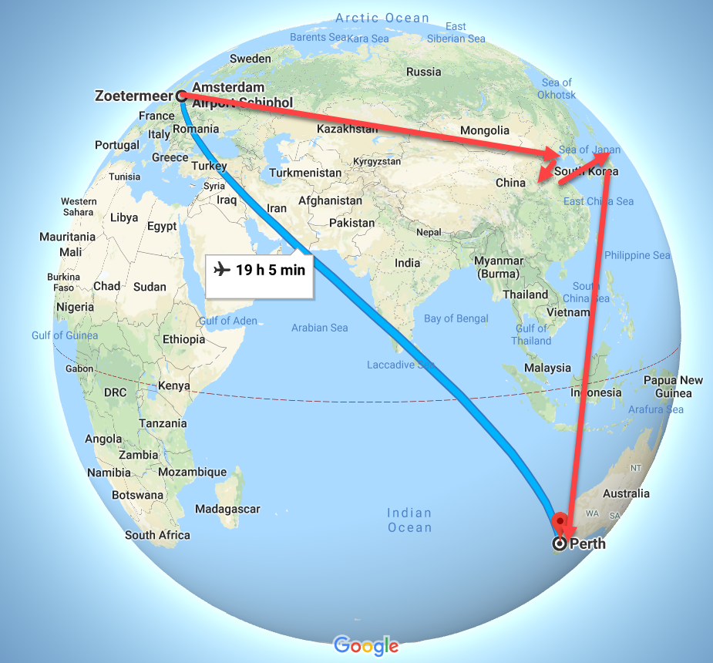
Tour of Asia & Pacific

Slide 4




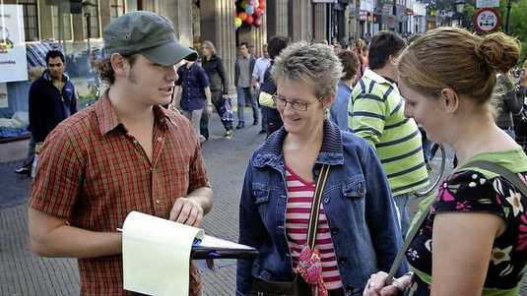
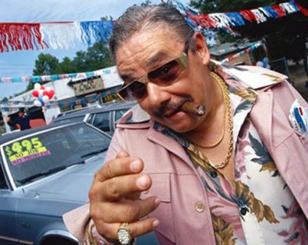
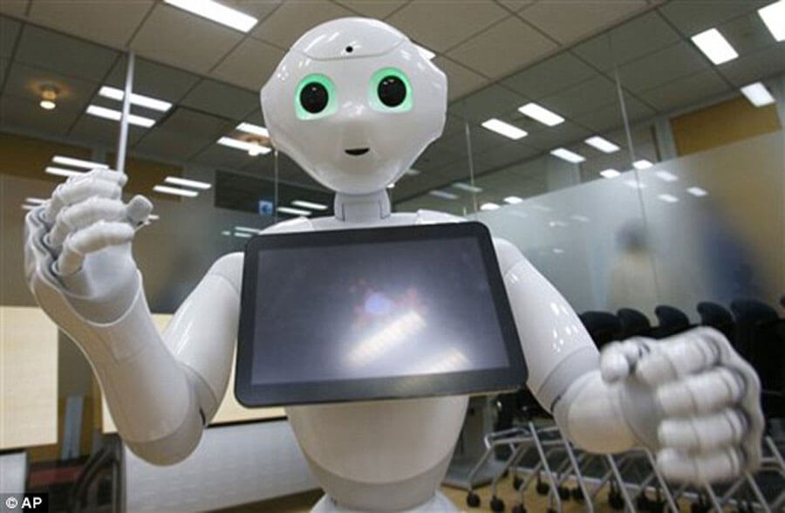

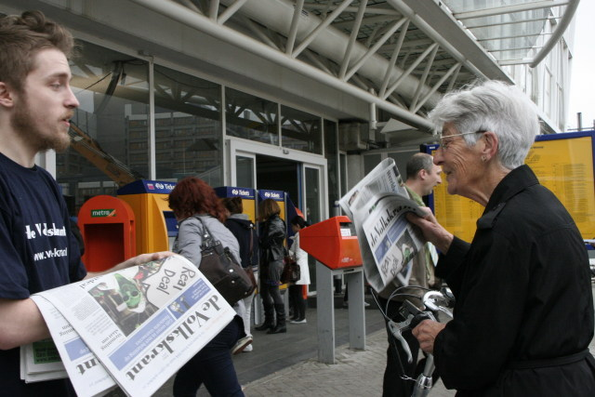

Slide 5
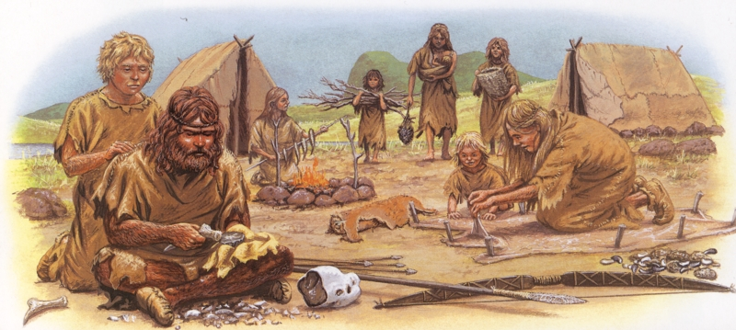
Notes:
Why do we study history?
To understand the present and predict the future (from current events)

Slide 6
Y = F(x)

Slide 7
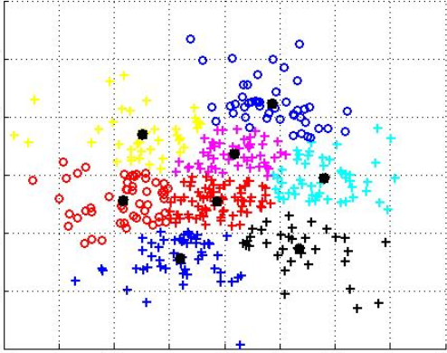
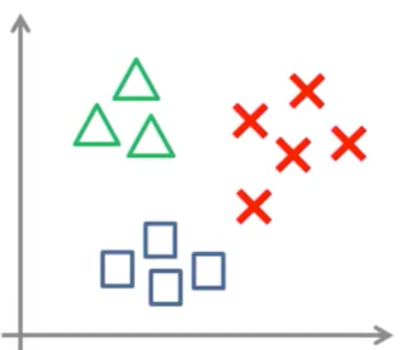
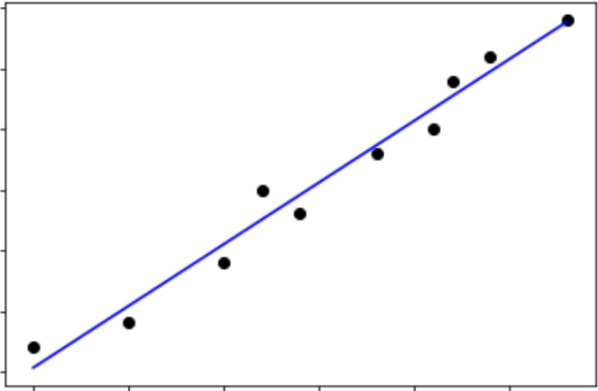
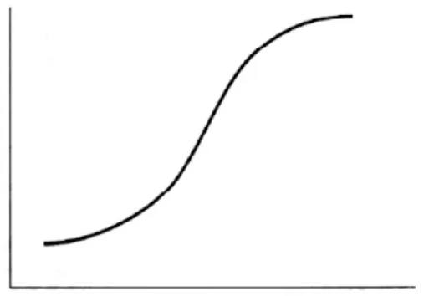
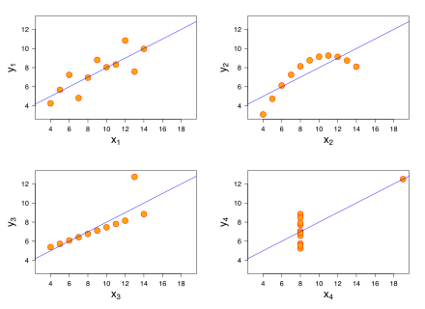
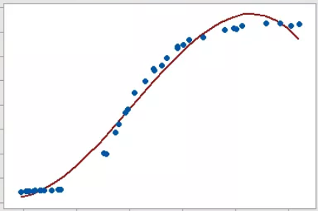
Y = F(x)

Slide 8
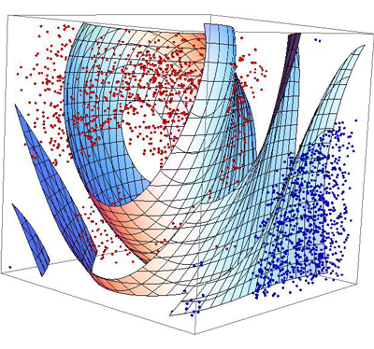
X = [x₁,x₂,x₃,…,x_{n}]

Slide 9
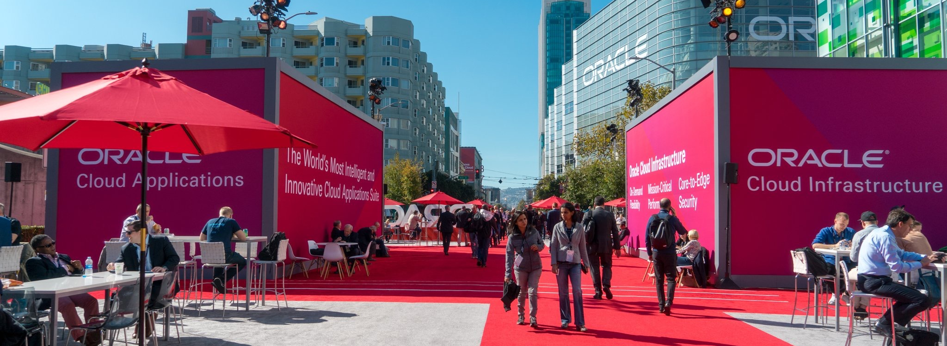
Oracle OpenWorld 2018 (Two weeks ago)
Notes:
Fast data arrives in real time and potentially high volume. Rapid processing, filtering and aggregation is required to ensure timely reaction and actual information in user interfaces. Doing so is a challenge, make this happen in a scalable and reliable fashion is even more interesting. This session introduces Apache Kafka as the scalable event bus that takes care of the events as they flow in and Kafka Streams and KSQL for the streaming analytics. Both Java and Node applications are demonstrated that interact with Kafka and leverage Server Sent Events and WebSocket channels to update the Web UI in real time. User activity performed by the audience in the Web UI is processed by the Kafka powered back end and results in live updates on all clients.
Fast data arrives in real time and potentially high volume. Rapid processing, filtering and aggregation is required to ensure timely reaction and actual information in user interfaces. Doing so is a challenge, make this happen in a scalable and reliable fashion is even more interesting. This session introduces Apache Kafka as the scalable event bus that takes care of the events as they flow in and Kafka Streams for the streaming analytics. Both Java and Node applications are demonstrated that interact with Kafka and leverage Server Sent Events and WebSocket channels to update the Web UI in real time. User activity performed by the audience in the Web UI is processed by the Kafka powered back end and results in live updates on all clients. Introducing the challenge: fast data, scalable and decoupled event handling, streaming analytics Introduction of Kafka demo of Producing to and consuming from Kafka in Java and Nodejs clients Intro Kafka Stream API for streaming analytics Demo streaming analytics from java client Intro of web ui: HTML 5, WebSocket channel and SSE listener Demo of Push from server to Web UI - in general End to end flow: - IFTTT picks up Tweets and pushed them to an API that hands them to Kafka Topic. - The Java application Consumes these events, performs Streaming Analytics (grouped by hashtag and author and time window) and counts them; the aggregation results are produced to Kafka - The NodeJS application consumes these aggregation results and pushes them to Web UI - The WebUI displays the selected Tweets along with the aggregation results - in the Web UI, users can LIKE and RATE the tweets; each like or rating is sent to the server and produced to Kafka; these events are processed too through Stream Analytics and result in updated Like counts and Average Rating results; these are then pushed to all clients; this means that the audience can Tweet, see the tweet appear in the web ui on their own device, rate & like and see the ratings and like count update in real time

Slide 10
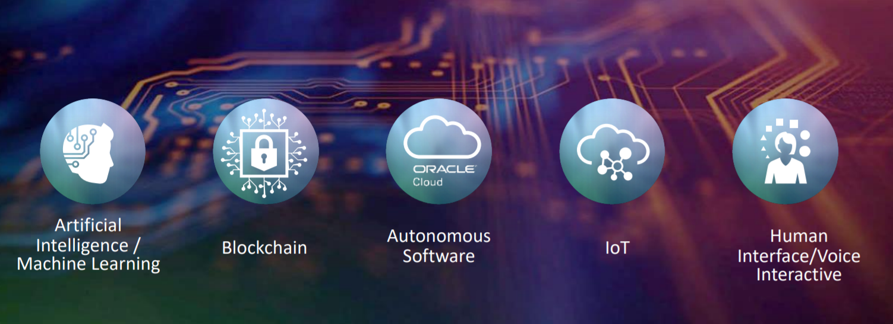
Main innovation themes

Slide 11
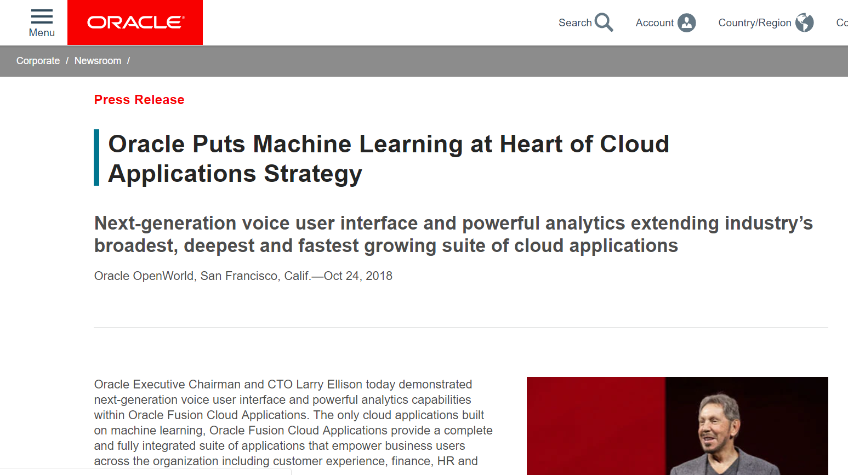
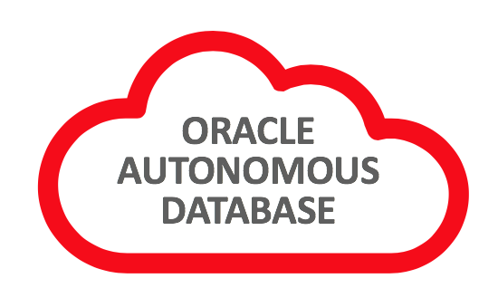
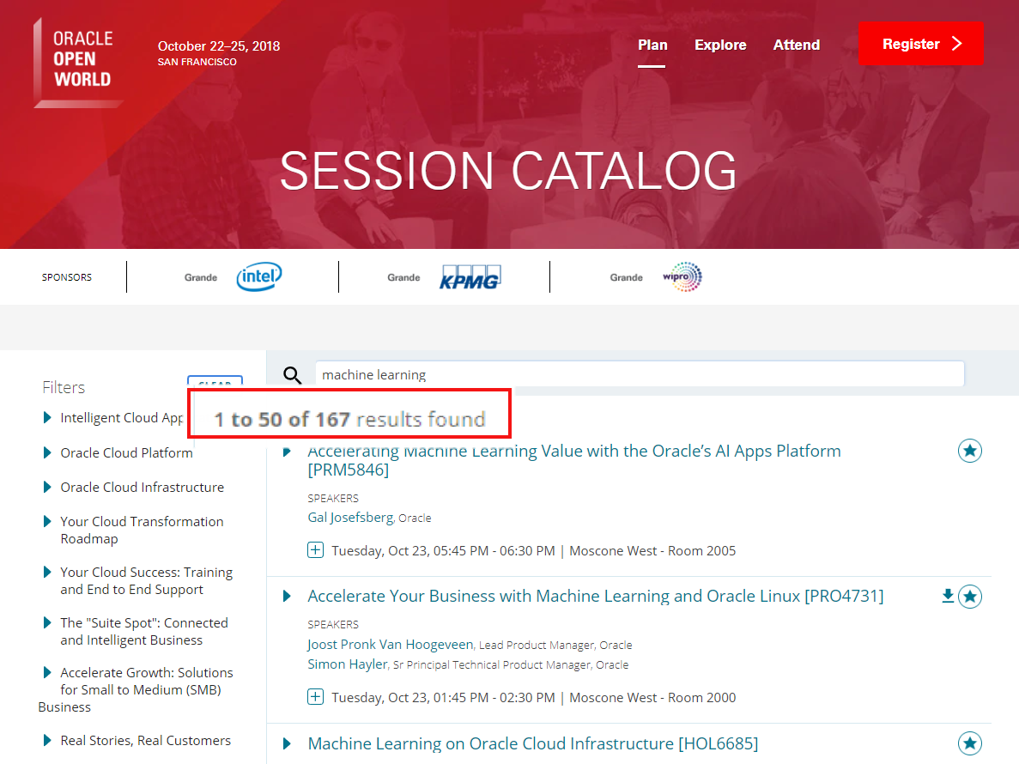
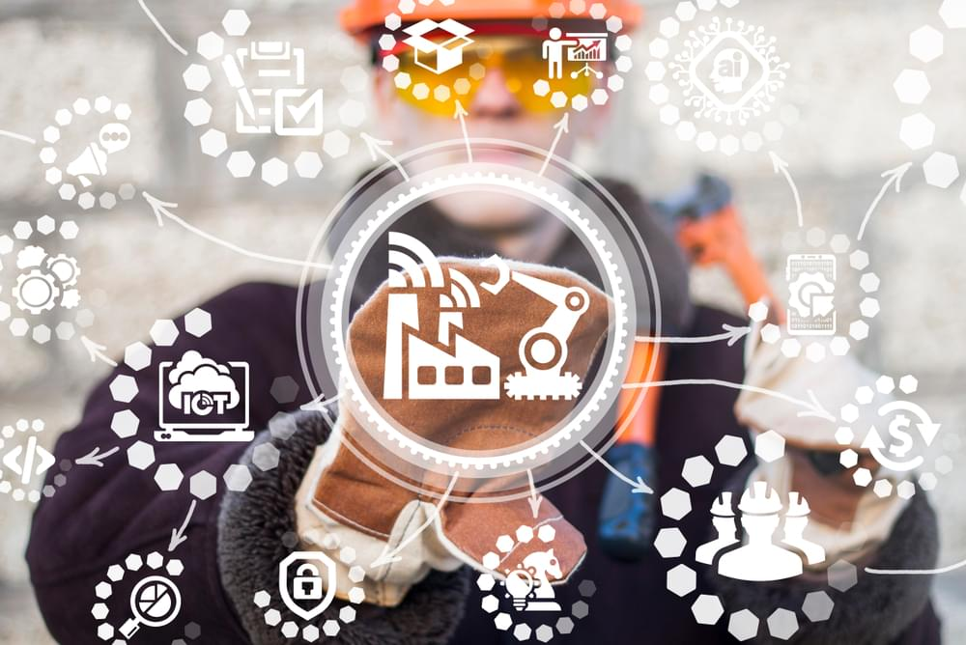

Oracle OpenWorld 2018
Real Time IoT Responses
Digital Assistant

Slide 12

Agenda
What is Machine Learning?
Why could it be relevant [to you]?
What does it entail?
With which algorithms, tools and technologies?
Oracle and Machine Learning?
How do you embark on Machine Learning?

Slide 13
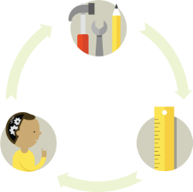
Learning
How do we learn?
Try something (else) => get feedback => learn
Eventually:
We get it (understanding) so we can predict the outcome of a certain action in a new situation
Or we have experienced enough situations to predict the outcome in most situations with high confidence
Through interpolation, extrapolation, etc.
We remain clueless

Slide 14
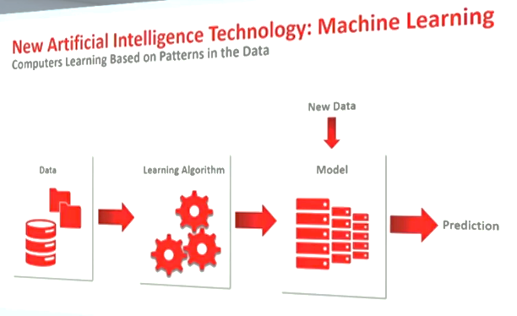
Machine Learning
Analyze Historical Data (input and result – training set) to discover Patterns & Models
Iteratively apply Models to [additional] Input (test set) and compare model outcome with known actual result to improve the model
Use Model to predict outcome for entirely new data

Slide 15
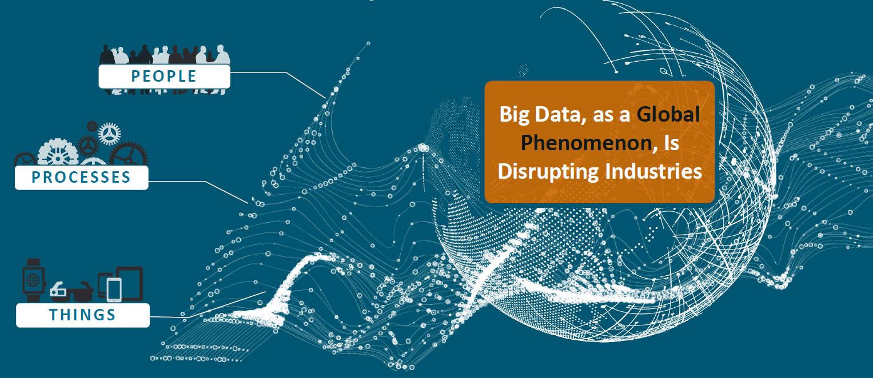
Why is it relevant (now)?
Data
big, fast, open
Machine Learning has become feasible and accessible
Available
Affordable (software & hardware)
Doable (Citizen Data Scientist)
Fast enough
Business Cases & Opportunities => Demands
End users, Consumers, Competitive pressure, Society
Notes:
IoT
Social Media

Slide 16
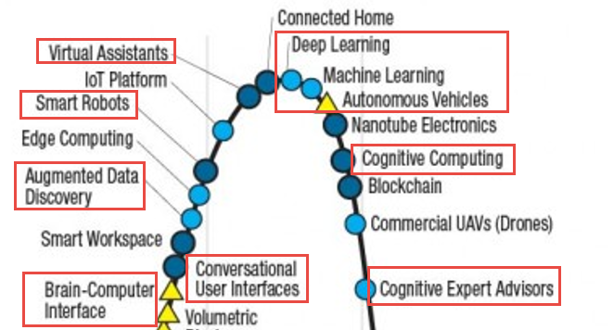
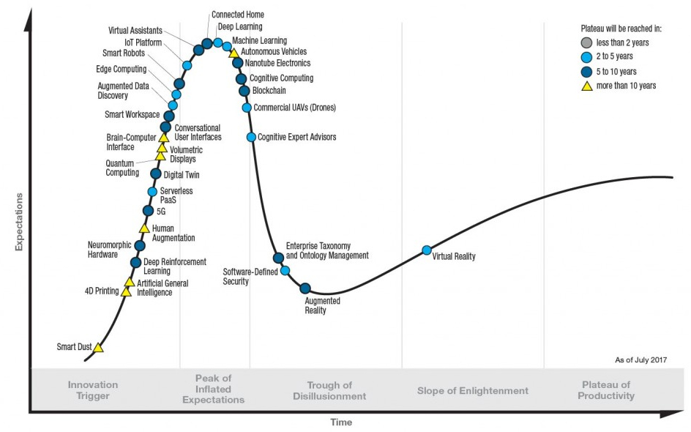
Why is it relevant (now)?
Notes:
IoT
Social Media

Slide 17
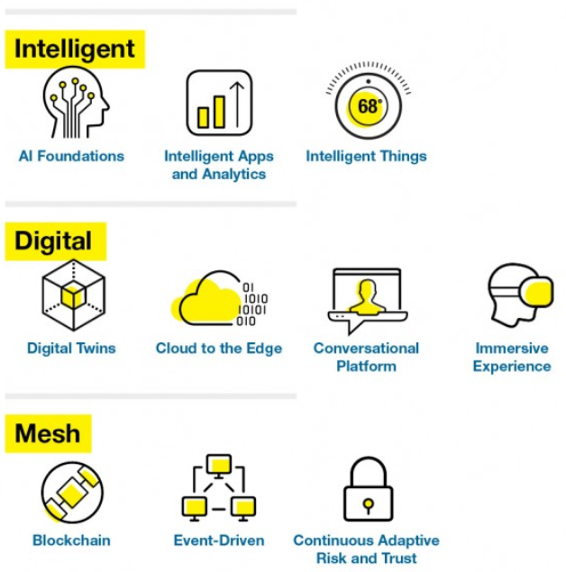
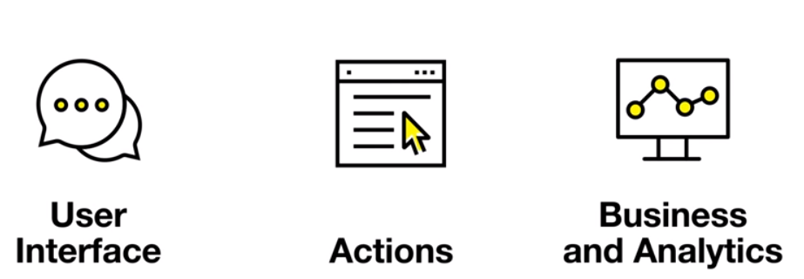
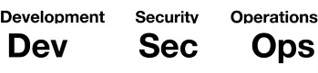
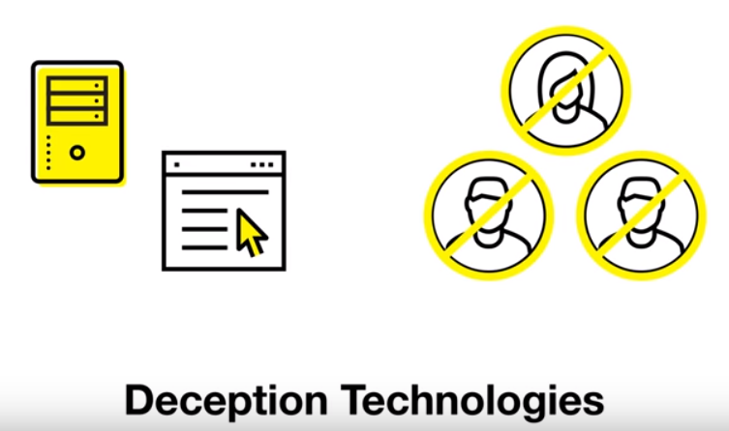
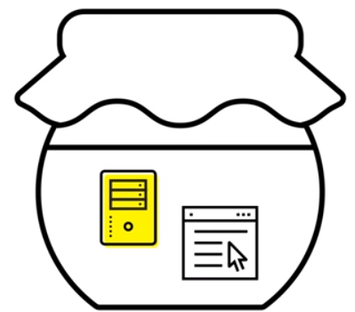
Gartner – Strategic Technology Trends 2018

Slide 18
Example use cases
Speech recognition
Identify churn candidates
Intent & Sentiment analysis on social media
Upsell & Cross Sell
Target Marketing
Customer Service
Chat bots & voice response systems
Predictive Maintenance
Gaming
Captcha
Medical Diagnosis
Anomaly Detection (find the odd one out)
Autonomous Cars
Autonomous Database
Identify heavy metal deposits from mineral finds
Voter Segment Analysis
Customer Recommendations
Smart Data Capture
Face Detection
Fraud Prevention
(really good) OCR
Traffic light control
Navigation
Should we investigate | do lab test?
Spam filtering
Propose friends | contacts
Troll detection
Auto correct
Photo Tagging and Album organization

Slide 19
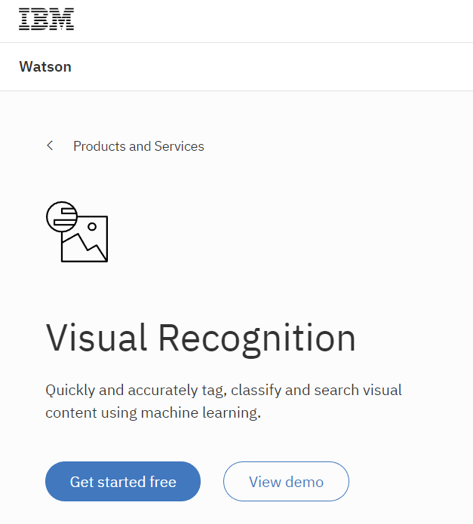
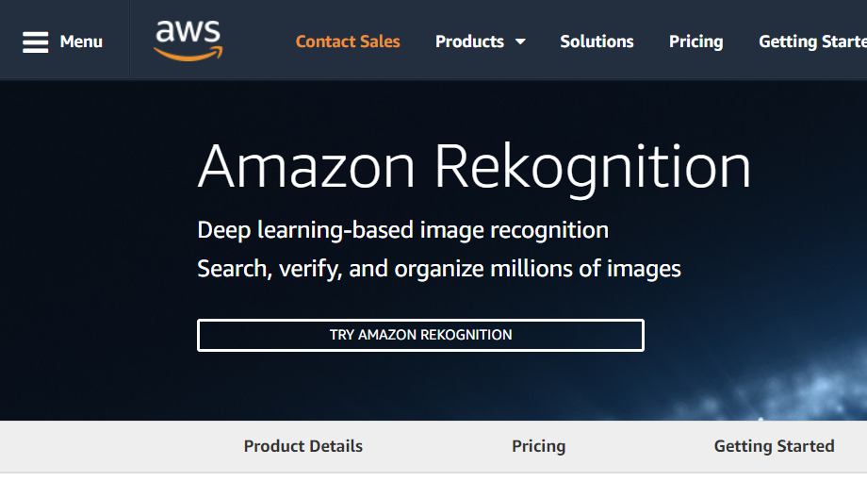
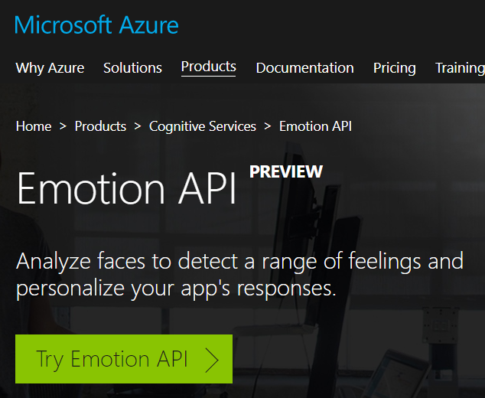
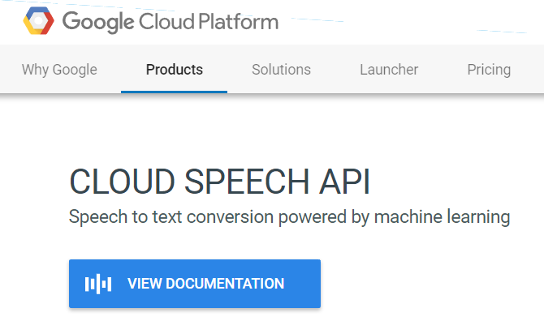
Ready-to-Run ML apps
Someone else selected, configured and trained an ML model and makes it available for you to use against your own data

Slide 20
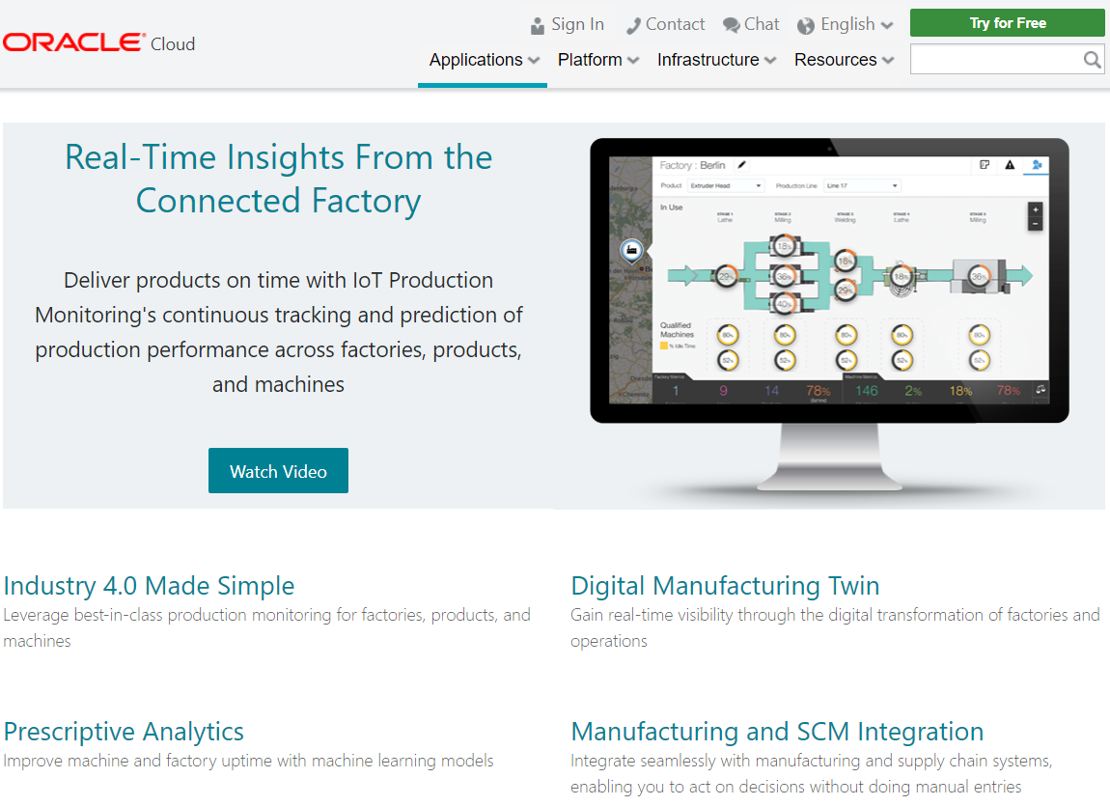
Ready to Run ML apps – SaaS powered by ML
#DevoxxMA

Slide 21
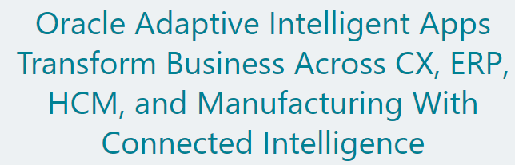
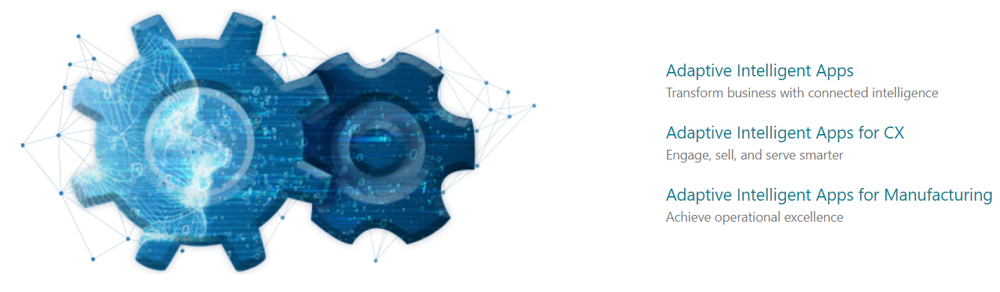
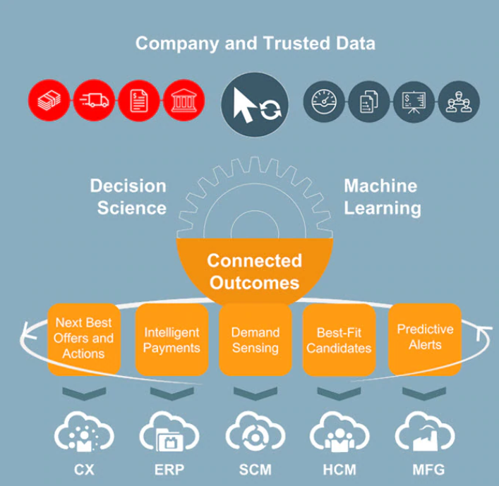
Ready to Run ML apps – SaaS powered by ML

Slide 22
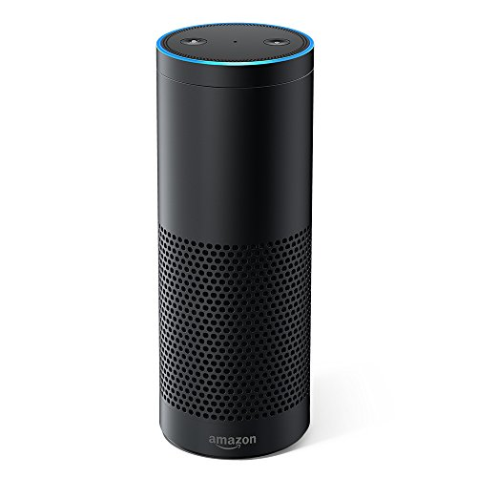
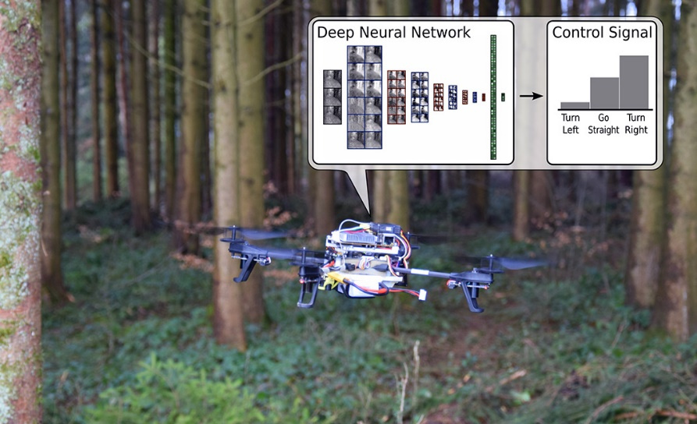
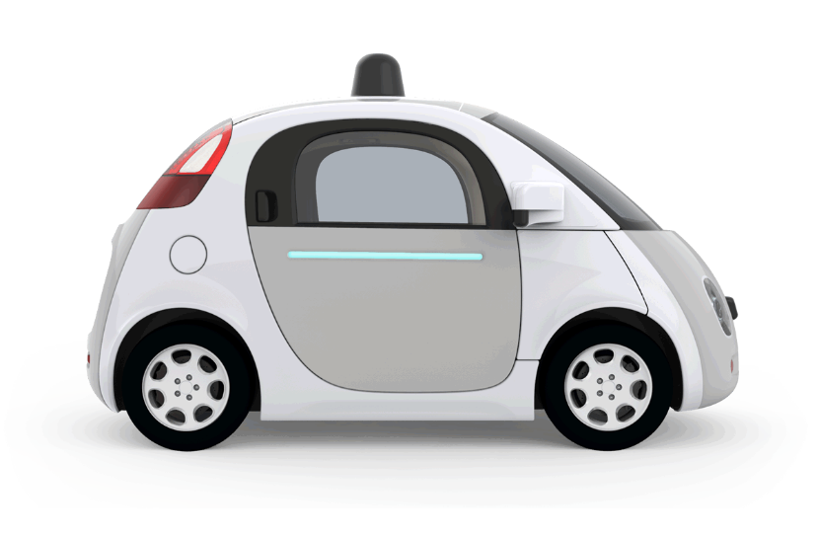

Products with ML inside

Slide 23
Do It Yourself
Machine Learning

Slide 24
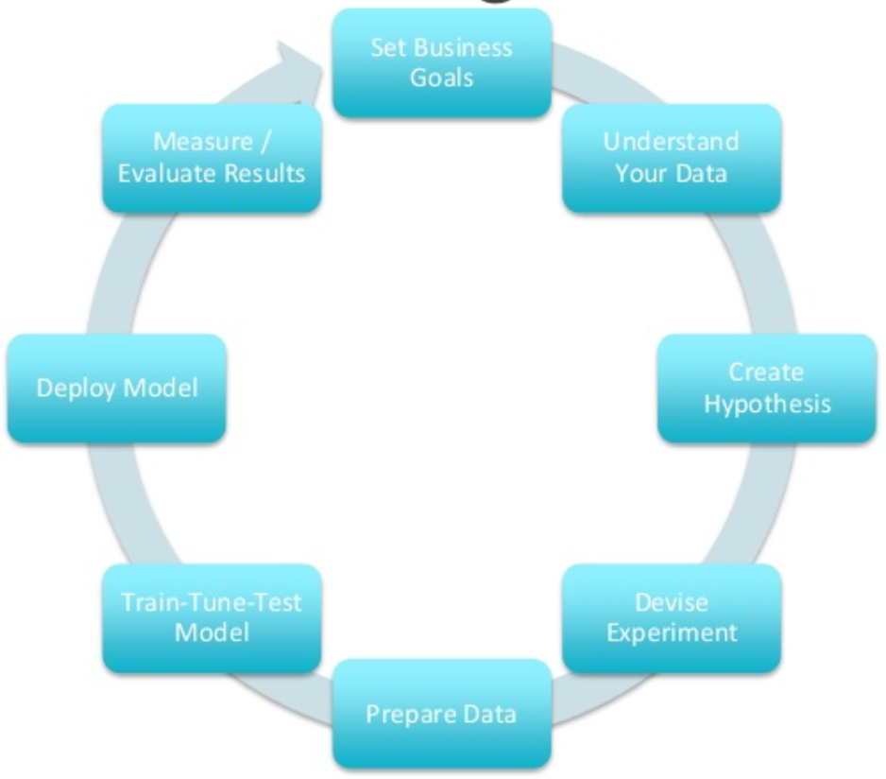

The Data Science workflow
Set Business Goal – research scope, objectives
Gather data
Prepare data
Cleanse, transform (wrangle), combine (merge, enrich)
Explore data
Model Data
Select model, train model, test model
Present findings and recommend next steps
Apply:
Make use of insights in business decisions
Automate Data Gathering & Preparation, Deploy Model, Embed Model in operational systems

Slide 25
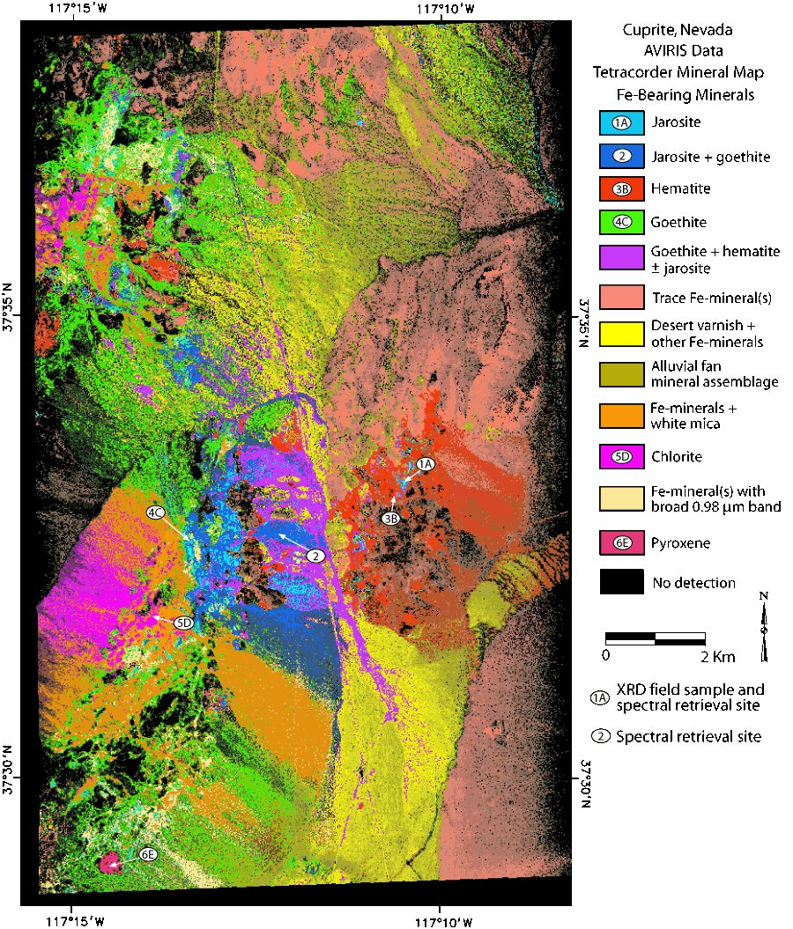
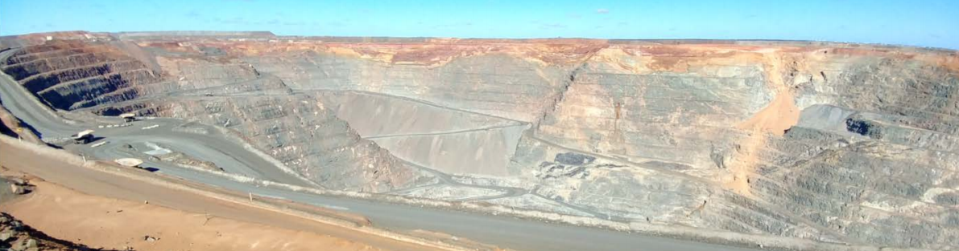
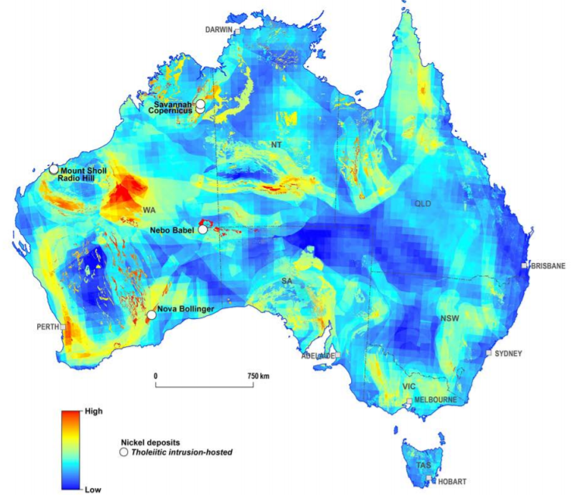
Data Mining

Slide 26
Data Discovery | exploration
A | B | C | D | E | F | G
1104534 | ZTR | 0.1 | anijs | 2 | 36 | T
631148 | ESE | 132 | rivier | 0 | 21 | S
-3 | WGN | 71 | appel | 0 | 1 | -
1262300 | ZTR | 56 | zes | 2 | 41 | T
315529 | HVN | 1290 | hamer | 0 | 11 | -
788914 | ASM | 676 | zwaluw | 0 | 26 | T
157762 | HVN | 9482 | wie | 0 | 6 | -
946681 | DHG | 42 | rond | 1 | 31 | T
-31539 | WGN | 2423 | bruin | 0 | 0 | -
47338 | HVN | 54 | hamer | 0 | 16 | P

Slide 27
Scatter Plot Attribute F (Y-axis)vs Attribute A

Slide 28
Scatter Plot Attribute F (Y-axis)vs Attribute A

Slide 29
Data Discovery – Attributes identified
Time of Birth | City | ? | ? | #Kids | Age | Level of Education
1104534 | ZTR | 0.1 | anijs | 2 | 36 | T
631148 | ESE | 132 | rivier | 0 | 21 | S
-3 | WGN | 71 | appel | 0 | 1 | -
1262300 | ZTR | 56 | zes | 2 | 41 | T
315529 | HVN | 1290 | hamer | 0 | 11 | -
788914 | ASM | 676 | zwaluw | 0 | 26 | T
157762 | HVN | 9482 | wie | 0 | 6 | -
946681 | DHG | 42 | rond | 1 | 31 | T
-31539 | WGN | 2423 | bruin | 0 | 0 | -
47338 | HVN | 54 | hamer | 0 | 16 | P

Slide 30
Types of Machine Learning
Supervised
Train and test model from known data (both features and target)
Unsupervised
Analyze unlabeled data – see if you can find anything
Semi-Supervised
Interactive flow, for example human identifying clusters
Reinforcement
Continuously improve algorithm (model) as time progresses, based on new experience

Slide 31

Machine Learning Algorithms
Clustering
Hierarchical k-means, Orthogonal Partitioning Clustering, Expectation-Maximization
Feature Extraction/Attribute Importance/Principal Component Analysis
Classification
Decision Tree, Naïve Bayes, Random Forest, Logistic Regression, Support Vector Machine
Regression
Multiple Regression, Support Vector Machine, Linear Model, LASSO, Random Forest, Ridgre Regression, Generalized Linear Model, Stepwise Linear Regression
Association & Collaborative Filtering (market basket analysis, apriori)
Reinforcement Learning – brute force, value function, Monte Carlo, temporal difference, ..
Neural network and Deep Learning with Deep Neural Network
Can be used for many different use cases
Notes:
Market Basket Analysis: https://www.linkedin.com/pulse/using-machine-learning-market-basket-analysis-thomsen

Slide 32
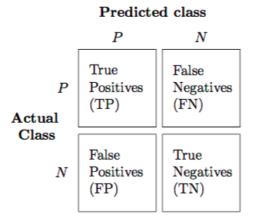
Modeling phase
Select a model to try to create a fit with (predict target well)
Set configuration parameters for model
Divide data in training set and test set
Train model with training set
Evaluate performance of trained model on the test set
Confusion matrix, mean square error, support, lift, false positives, false negatives
Optionally: tweak model parameters, add attributes, feed in more training data, choose different model
Eventually (hopefully): pick model plus parameters plus attributes that will reliably predict the target variable given new data
Possibly combine multiple models to collaborate on target value

Slide 33
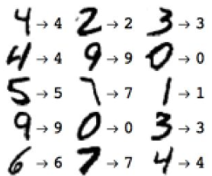
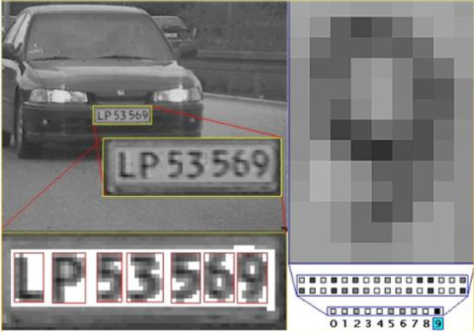
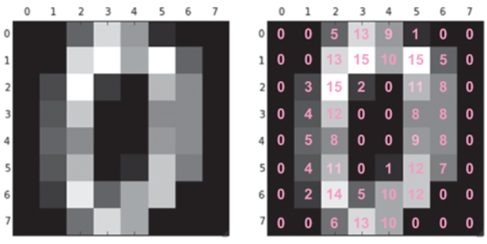




Optical Digit recognition == classification
Naïve Bayes
Predicted
0 1 2 3 4 5 6 7 8 9
0
1
2
3
4
5
6
7
8
9
Actual
Decision Tree
Deep Neural Network
Notes:
http://yann.lecun.com/exdb/mnist/ MNIST – handwritten images

Slide 34

Classification gone wrong
Machine learning applied to millions of drawings on QuickDraw
to classify drawings
For example: drawings of beds
See for example:
https://aiexperiments.withgoogle.com/quick-draw
Notes:
https://aiexperiments.withgoogle.com/quick-draw

Slide 35


Machine learning ⬄ operational systems
“We have a model that will choose the best chess move based on certain input”

Slide 36
Machine learning ⬄ operational systems
Discovery => Model => Deploy
“We have a model that will predict a class (classification) or value (regression) based on certain input with a meaningful degree of accuracy” – how can we make use of that model?

Slide 37
Deploy model and expose
Model is usually created on Big Data in Data Science environment using the Data Scientist’s tools
Model itself is typically fairly small
Model will be applied in operational systems against single data items (not huge collections nor the entire Big Data set)
Running the model online may not require extensive resources
Implementing the model at production run time
Export model (from Data Scientist environment) and import (into production environment)
Reimplement the model in the development technology and deploy (in the regular way) to the production environment
Expose model through API
Notes:
https://www.slideshare.net/databricks/apache-spark-model-deployment

Slide 38




80M Pictures of Road

Slide 39





Big Data => Small ML Models

Slide 40

Deploy model and expose
REST API
Notes:
https://www.slideshare.net/databricks/apache-spark-model-deployment

Slide 41





Applications leveraging smart APIs powered by Machine learning
REST API
Application

Slide 42
Model management
Governance (new versions, testing and approval)
A/B testing
Auditing (what did the model decide and why? notifying humans? )
Evaluation (how well did the model’s output match the reality) to help evolve the model
for example recommendations followed
Monitor self learning models (to detect rogue models)
Notes:
https://www.slideshare.net/databricks/apache-spark-model-deployment

Slide 43


Deployment can also be: load results from model into production

Slide 44





What to do it with?
Mathematics (Statistics)
Gauss (normal distribution)
Bayes’ Theorem
Euclidean Distance
Perceptron
Mean Square Error

Slide 45

What to do it with?

Slide 46

Tools and libraries implementing machine learning algorithms
+

Slide 47
And of Course
DATA
DATA
DATA
DATA
DATA
DATA

Slide 48
How to pick Tools for the job
What are the jobs?
Gather data
Prepare data
Explore and (hopefully) Discover
Present
Embed & Deploy Model
What are considerations?
Volume
Speed and Time
Skills
Platform
Cost

Slide 49



Popular technologies

Slide 50




Popular Tools, frameworks & libraries
TensorFlow
MXNet
Caffe
DL4J
Keras
… many more… Oracle Database Option Advanced Analytics
Notes:
https://www.slideshare.net/AshishBansal17/tensorflow-vs-mxnet

Slide 51



Notebook – The Lab journal from the Datalab
Common format for data exploration and presentation
User friendly interface on top of powerful technologies
Most popular implementations
Jupyter (fka IPython)
Apache Zeppelin (in Autonomous DWH Cloud)
Spark Notebook
Beaker
SageMath (SageMathCloud => CoCalc)
Oracle Machine Learning Notebook UI
Try out Jupyter at: https://mybinder.org/
Watch our for KubeFlow
Machine Learning for Kubernetes platform

Slide 52

Example notebook exploration
Notes:
https://github.com/lucasjellema/theArtOfMachineLearning/blob/master/LinearRegression.ipynb
https://nbviewer.jupyter.org/github/lucasjellema/devoxx17-intro-machine-learning/blob/master/LinearRegression.ipynb
https://github.com/lucasjellema/jupyter-notebook-eredivisie/blob/master/EredivisieResults_2016_2017.ipynb
https://github.com/jadianes/spark-movie-lens/blob/master/notebooks/building-recommender.ipynb
https://github.com/justmarkham/DAT4/blob/master/notebooks/08_linear_regression.ipynb

Slide 53

Open Data
Governments and NGOs, scientific and even commercial organizations are publishing data
Inviting anyone who wants to join in to help make sense of the data – understand driving factors, identify categories, help predict
Many areas
Economy, health, public safety, sports, traffic & transportation, games, environment, maps, …
Notes:
https://openflights.org/data.html - airports, airlines, flight routes
Google Audio Set - https://research.google.com/audioset/ (A large-scale dataset of manually annotated audio events)
Open Images Data Set - https://github.com/openimages/dataset , www.image-net.org
http://api.football-data.org/index
UK Data - https://data.gov.uk/
Open Data Sets - https://www.kaggle.com/datasets
CBS Open Data - https://www.cbs.nl/nl-nl/onze-diensten/open-data
Open Data Sets for Deep learning - https://deeplearning4j.org/opendata
Data.gov The home of the US Government’s open data
https://open-data.europa.eu/ The home of the European Commission’s open data
https://www.wikidata.org (in part originated out of Freebase.org An open database that retrieves its information from sites like Wikipedia, MusicBrains, and the SEC archive )
Data.worldbank.org Open data initiative from the World Bank
Aiddata.org Open data for international development
Open.fda.gov Open data from the US Food and Drug Administration
Google Knowledge Graph API - https://developers.google.com/knowledge-graph/
Detroit Open Data Portal https://data.detroitmi.gov/
Example: Detroit Police Crime statistics: https://data.detroitmi.gov/Public-Safety/-Archived-All-Crime-Incidents-2009-May-5-2017/b4hw-v6w2

Slide 54



Open Data – some examples
Kaggle - Data Sets and [Samples of] Data Discovery: www.kaggle.com
India Government - data.gov.in
US, EU and UK Government Data: data.gov, open-data.europa.eu and data.gov.uk
Open Images Data Set: www.image-net.org
Open Data From World Bank: data.worldbank.org
Historic Football Data: api.football-data.org
New York City Open Data - opendata.cityofnewyork.us
Airports, Airlines, Flight Routes: openflights.org
Open Database – machine counterpart to Wikipedia: www.wikidata.org
Google Audio Set (manually annotated audio events) - research.google.com/audioset/
Movielens - Movies, viewers and ratings: files.grouplens.org/datasets/movielens/
Notes:
https://openflights.org/data.html - airports, airlines, flight routes
Google Audio Set - https://research.google.com/audioset/ (A large-scale dataset of manually annotated audio events)
Open Images Data Set - https://github.com/openimages/dataset , www.image-net.org
http://api.football-data.org/index
http://files.grouplens.org/datasets/movielens/ml-latest-small-README.html
UK Data - https://data.gov.uk/
Open Data Sets - https://www.kaggle.com/datasets
CBS Open Data - https://www.cbs.nl/nl-nl/onze-diensten/open-data
Open Data Sets for Deep learning - https://deeplearning4j.org/opendata
Data.gov The home of the US Government’s open data
https://open-data.europa.eu/ The home of the European Commission’s open data
https://www.wikidata.org (in part originated out of Freebase.org An open database that retrieves its information from sites like Wikipedia, MusicBrains, and the SEC archive )
Data.worldbank.org Open data initiative from the World Bank
Aiddata.org Open data for international development
Open.fda.gov Open data from the US Food and Drug Administration
Google Knowledge Graph API - https://developers.google.com/knowledge-graph/
Detroit Open Data Portal https://data.detroitmi.gov/
Example: Detroit Police Crime statistics: https://data.detroitmi.gov/Public-Safety/-Archived-All-Crime-Incidents-2009-May-5-2017/b4hw-v6w2

Slide 55


What is Hadoop?
Big Data means Big Computing and Big Storage
Big requires scalable => horizontal scale out
Moving data is very expensive (network, disk IO)
Rather than move data to processor – move processing to data: distributed processing
Horizontal scale out => Hadoop: distributed data & distributed processing
HDFS – Hadoop Distributed File System
Map Reduce – parallel, distributed processing
Map-Reduce operates on data locally, then persists and aggregates results

Slide 56
What is Spark?
Developing and orchestrating Map-Reduce on Hadoop Big Data is not simple
Running jobs can be slow due to frequent disk writing
Spark is for managing and orchestrating distributed processing on a variety of cluster systems
with Hadoop as the most obvious target
through APIs in Java, Python, R, Scala
Spark uses lazy operations and distributed in-memory data structures – offering much better performance
Through Spark – cluster based processing can be used interactively
Spark has additional modules that leverage distributed processing for running prepackaged jobs (SQL, Graph, ML, …)

Slide 57

Apache Spark overview

Slide 58

Example running Notebook against Apache Spark
https://github.com/jadianes/spark-movie-lens/blob/master/notebooks/building-recommender.ipynb
Notes:
https://github.com/jadianes/spark-movie-lens/blob/master/notebooks/building-recommender.ipynb

Slide 59


What is Oracle doing around Machine Learning?
Oracle Advanced Analytics in Oracle Database
Data Mining, Enterprise R
Text (ESA), Spatial, Graph
SQL
Notes:
https://www.oracle.com/big-data/big-data-discovery/index.html
https://labs.oracle.com/pls/apex/f?p=labs:49:::::P49_PROJECT_ID:7
https://technology.amis.nl/2004/10/16/hidden-plsql-gem-in-10g-dbms_frequent_itemset-for-plsql-based-data-mining/
http://oracledmt.blogspot.nl/2006/05/sql-of-analytics-1-data-mining.html

Slide 60



Demo: Classification

Slide 61


Demo: Conference Abstract Classification Challenge
Take all conference abstracts for (2017)
Train a Classification Model on picking the Conference Track
Based on Title, Summary [, Speaker, Level,…]
Use the Model to pick the Track for sessions at

Slide 62
Demonstration of Oracle Advanced Analytics
Using Text Mining and Naives Bayes Data Mining Classification
Train model for classifying conference abstracts into tracks
Use model to propose a track for new abstracts
Steps
Gather data
Import, cleanse, enrich, …
Prepare training set and test set
Select and configure model
Combining Text and Mining using Naive Bayes
Train model
Test and apply model

Slide 63

Prepare database (in the cloud)

Slide 64

Prepare database (in the cloud)

Slide 65

Completing the database instance

Slide 66

Once the instance is running...

Slide 67

Use as any Oracle database instance – local, on premises, ... – accessible via SQL*Net

Slide 68


Create table with J1_sessions

Slide 69
Train model on classifying on track
DECLARE
xformlist dbms_data_mining_transform.TRANSFORM_LIST;
BEGIN
DBMS_DATA_MINING_TRANSFORM.SET_TRANSFORM ( xformlist, 'abstract', NULL, 'abstract', NULL, 'TEXT(TOKEN_TYPE:NORMAL)’ );
DBMS_DATA_MINING.CREATE_MODEL ( model_name => 'SESSION_CLASS_NB'
, mining_function => dbms_data_mining.classification
, data_table_name => 'J1_SESSIONS'
, case_id_column_name => 'session_title'
, target_column_name => 'session_track'
, settings_table_name => 'session_class_nb_settings'
, xform_list => xformlist);
END;

Slide 70

Apply model to derive track

Slide 71

Apply model to categorize codeone 2018 session proposals into tracks

Slide 72

Automatic Machine Predicted tracks for codeone proposed sessions

Slide 73

Big Data SQL Oracle Database as single point of entry

Slide 74











Many cloud services around Big Data & [predictive] Analytics & Machine learning

Slide 75


Oracle’s Machine Learning architecture
Analytics
Cloud
OLTP
IoT
Social

Slide 76



What is Oracle doing around Machine Learning?
Autonomous Data Warehouse
Data mining & ML algorithms
R & SQL in Database
Apache Zeppelin based Notebook for Machine Learning (data science lab)
Big Data [SQL] Cloud
Managed Hadoop & Apache Spark
Run SQL Analytics across data sources
Analytics Cloud
Data Science Cloud
Data Science Collaboration platform
Notebook based projects
Curated Data Exploration & Machine Learning environments
Model-deployment & API publication

Slide 77


Oracle AI Platform Cloud Service (coming shortly)

Slide 78

Oracle Data Science Cloud

Slide 79

Based on:
Data Science Cloud
Data Science Collaboration platform
Notebook based projects
Curated Data Exploration & Machine Learning environments
Model-deployment & API publication

Slide 80


Humans learning machine learning: Your first steps
#DevoxxMA

Slide 81



Humans learning machine learning: Your first steps
Jupyter Notebooks and Python – https://mybinder.org/
HortonWorks Sandbox VM – Hadoop & Spark & Hive, Ambari
DataBricks Cloud Environment with Apache Spark (free trial)
Katacoda – tutorials & live environments
Oracle Cloud Trial
Autonomous Data Warehouse Cloud, Analytics Cloud, Data Science Platform (coming)
KubeFlow – ready to run Machine Learning stack on Kubernetes
Tutorials, Courses (Udacity, Coursera, edX)
Books
Introducing Data Science
Learning Apache Spark 2
Python Machine Learning
Notes:
http://tmpnb.org
http://www.oracle.com/technetwork/database/bigdata-appliance/oracle-bigdatalite-2104726.html
https://www.udacity.com/course/intro-to-machine-learning--ud120
https://www.coursera.org/learn/machine-learning#%20
https://www.edx.org/course/machine-learning-columbiax-csmm-102x-0
https://technology.amis.nl/2017/05/06/the-hello-world-of-machine-learning-with-python-pandas-jupyter-doing-iris-classification-based-on-quintessential-set-of-flower-data/
https://github.com/rhiever/Data-Analysis-and-Machine-Learning-Projects/blob/master/example-data-science-notebook/Example%20Machine%20Learning%20Notebook.ipynb
https://databricks.com/try-databricks
https://hortonworks.com/products/sandbox/
http://www.oracle.com/technetwork/middleware/oracle-data-visualization/downloads/oracle-data-visualization-desktop-2938957.html

Slide 82
Summary
IoT, Big Data, Machine Learning => AI
Recent and Rapid Democratization of Machine Learning
Algorithms, Storage and Compute Resources, High Level Machine Learning Frameworks, Education resources , Open Data, Trained ML Models, Out of the Box SaaS capabilities – powered by ML
Produce business value today
Machine Learning by computers helps us(ers) understand historic data and apply that insight to new data
Developers have to learn how to incorporate Machine Learning into their applications – for smarter UIs, more automation, faster (p)reactions

Slide 83
Summary
R and Python are most popular technologies for data exploration and ML model discovery [on small subsets of Big Data]
Apache Spark (on Hadoop) is frequently used to powercrunch data (wrangling) and run SQL and ML models on Big Data sets
Notebooks are a popular vehicle in the Data Science lab
To explore and report
Oracle is quite active on Machine Learning
Power PaaS and SaaS with ML
Provide us with the Machine Learning Data Lab & Run Time (on the cloud)
Getting started on Machine Learning is fun, smart & well supported

Slide 84




Thank you Dank je wel
Blog: technology.amis.nl
Email: lucas.jellema@amis.nl
: @lucasjellema
: lucas-jellema
: www.amis.nl, info@amis.nl

Slide 85
References
AI Adventures (Google) https://www.youtube.com/watch?v=RJudqel8DVA
Twitch TV https://www.twitch.tv/videos/179940629 and sources on GitHub: https://github.com/sunilmallya/dl-twitch-series
Tensor Flow & Deep Learning without a PhD (Devoxx) https://www.youtube.com/watch?v=vq2nnJ4g6N0
KataKoda Browser Based Runtime for TensorFlow https://www.katacoda.com/courses/tensorflow
And many more
#DevoxxMA

